Slide 1


Bennet Hörmann, Salomo Hummel, Simeon Schrape, Erik Wu, Udo Zucker

Slide 2


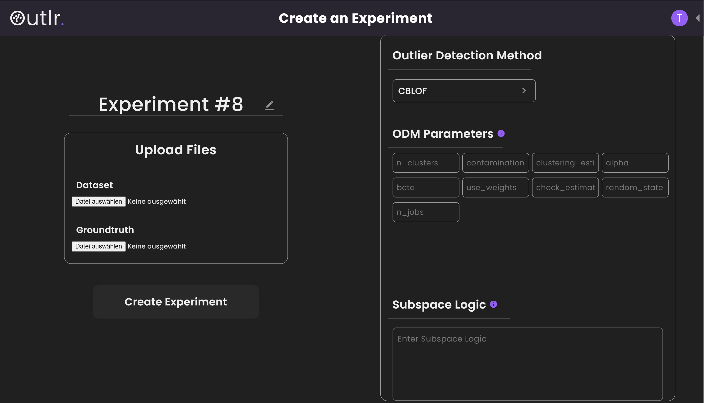
Motivation
outliers can degrade ML methods
not many platforms for subspace outliers
Outlr. provides accessible + intuitive Interface

Slide 3
Outlier
1
data point that differs significantly from other data points
1

Slide 4
Subspace Outliers
1
data points which are outliers in certain subspaces
1

Slide 5
Subspace Outliers
x = „feature 1“ | y = „feature 2“
2.8391146111970698 | 3.1390820095218572
2.8428654177443216 | 3.1894471104030235
3.305442968608614 | 2.8697267596737555
3.0054629889589455 | 3.1304537686350637
2.785299474561798 | 3.001912971003542
3.1416954644354615 | 3.2134305096501703
3.1416954644354615 | 2.935325810188675
1.1204982390 | 5.432089437928
1
1

Slide 6
Subspace Outliers
x = „feature 1“ | y = „feature 2“
2.8391146111970698 | 3.1390820095218572
2.8428654177443216 | 3.1894471104030235
3.305442968608614 | 2.8697267596737555
3.0054629889589455 | 3.1304537686350637
2.785299474561798 | 3.001912971003542
3.1416954644354615 | 3.2134305096501703
3.1416954644354615 | 2.935325810188675
1.1204982390 | 5.432089437928
1
1

Slide 7
Subspace Outliers
x = „feature 1“ | y = „feature 2“
2.8391146111970698 | 3.1390820095218572
2.8428654177443216 | 3.1894471104030235
3.305442968608614 | 2.8697267596737555
3.0054629889589455 | 3.1304537686350637
2.785299474561798 | 3.001912971003542
3.1416954644354615 | 3.2134305096501703
3.1416954644354615 | 2.935325810188675
1.1204982390 | 5.432089437928
1
1

Slide 8
Subspace Outliers
x = „feature 1“ | y = „feature 2“
2.8391146111970698 | 3.1390820095218572
2.8428654177443216 | 3.1894471104030235
3.305442968608614 | 2.8697267596737555
3.0054629889589455 | 3.1304537686350637
2.785299474561798 | 3.001912971003542
3.1416954644354615 | 3.2134305096501703
3.1416954644354615 | 2.935325810188675
1.1204982390 | 5.432089437928
1
1

Slide 9
Subspace Outliers
x = „feature 1“ | y = „feature 2“
2.8391146111970698 | 3.1390820095218572
2.8428654177443216 | 3.1894471104030235
3.305442968608614 | 2.8697267596737555
3.0054629889589455 | 3.1304537686350637
2.785299474561798 | 3.001912971003542
3.1416954644354615 | 3.2134305096501703
3.1416954644354615 | 2.935325810188675
1.1204982390 | 5.432089437928
1
1

Slide 10
Subspace Outliers
x = „feature 1“ | y = „feature 2“
2.8391146111970698 | 3.1390820095218572
2.8428654177443216 | 3.1894471104030235
3.305442968608614 | 2.8697267596737555
3.0054629889589455 | 3.1304537686350637
2.785299474561798 | 3.001912971003542
3.1416954644354615 | 3.2134305096501703
3.1416954644354615 | 2.935325810188675
1.1204982390 | 5.432089437928
1
1

Slide 11
Subspace Outliers
x = „feature 1“ | y = „feature 2“
2.8391146111970698 | 3.1390820095218572
2.8428654177443216 | 3.1894471104030235
3.305442968608614 | 2.8697267596737555
3.0054629889589455 | 3.1304537686350637
2.785299474561798 | 3.001912971003542
3.1416954644354615 | 3.2134305096501703
3.1416954644354615 | 2.935325810188675
1.1204982390 | 5.432089437928
1
1

Slide 12
Problem

Slide 13
Solution

Slide 14
Live Demo

Slide 15
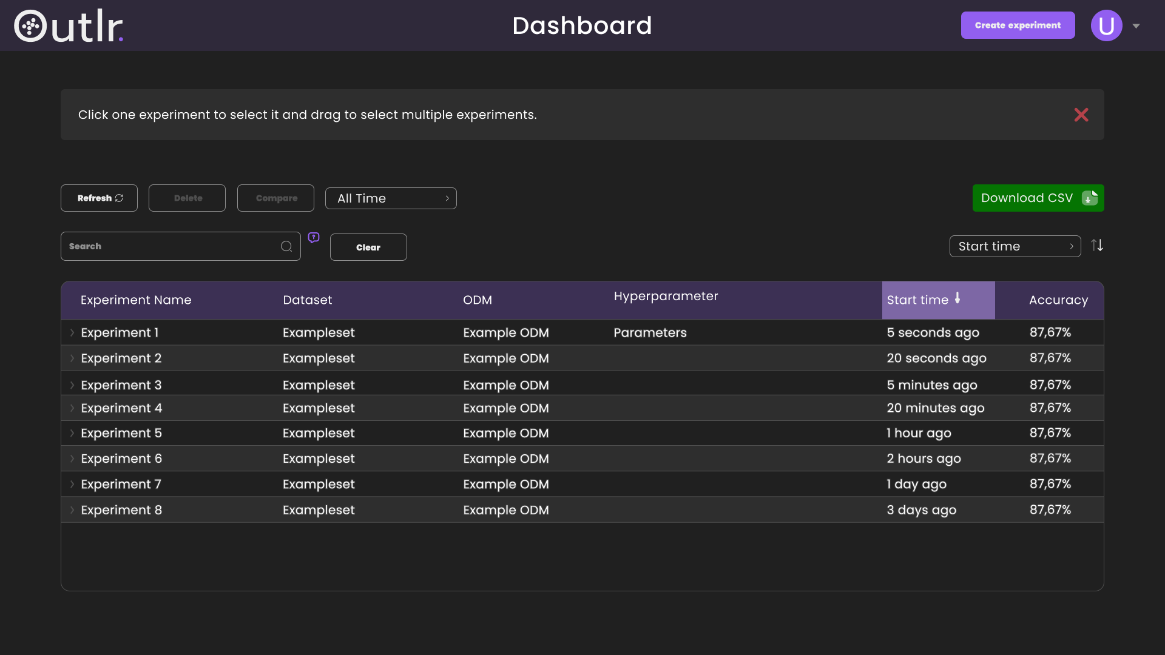

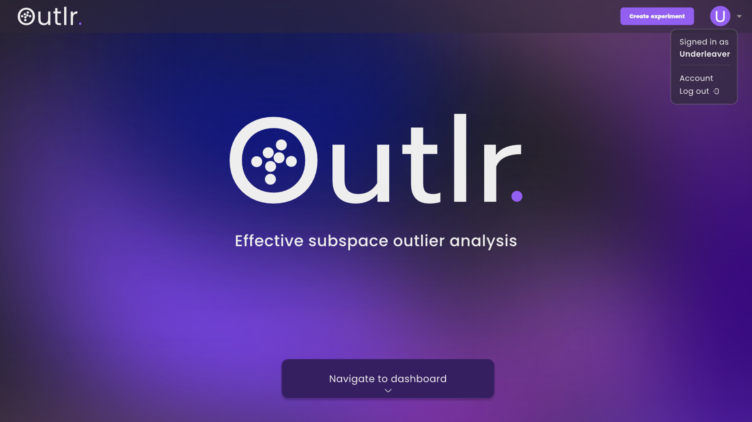
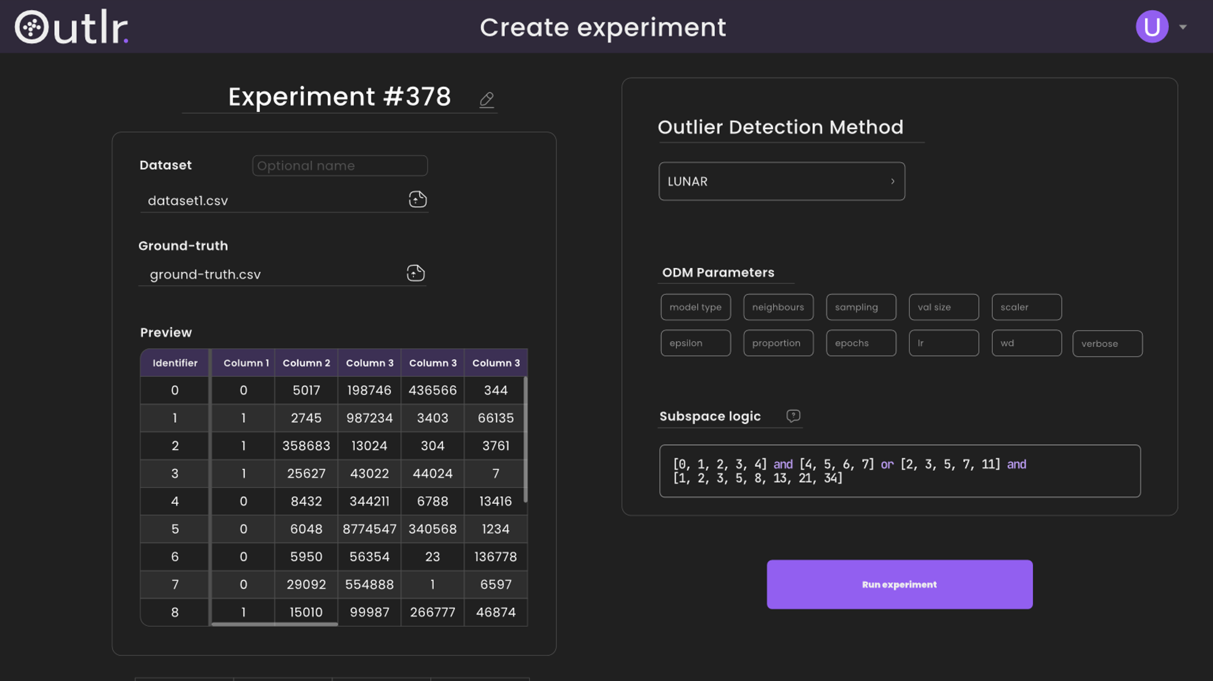
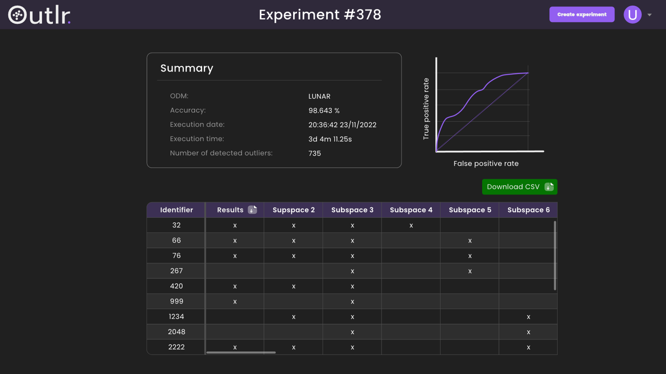
Requirements Specification
Product functions and requirements
GUI Mockups

Slide 16

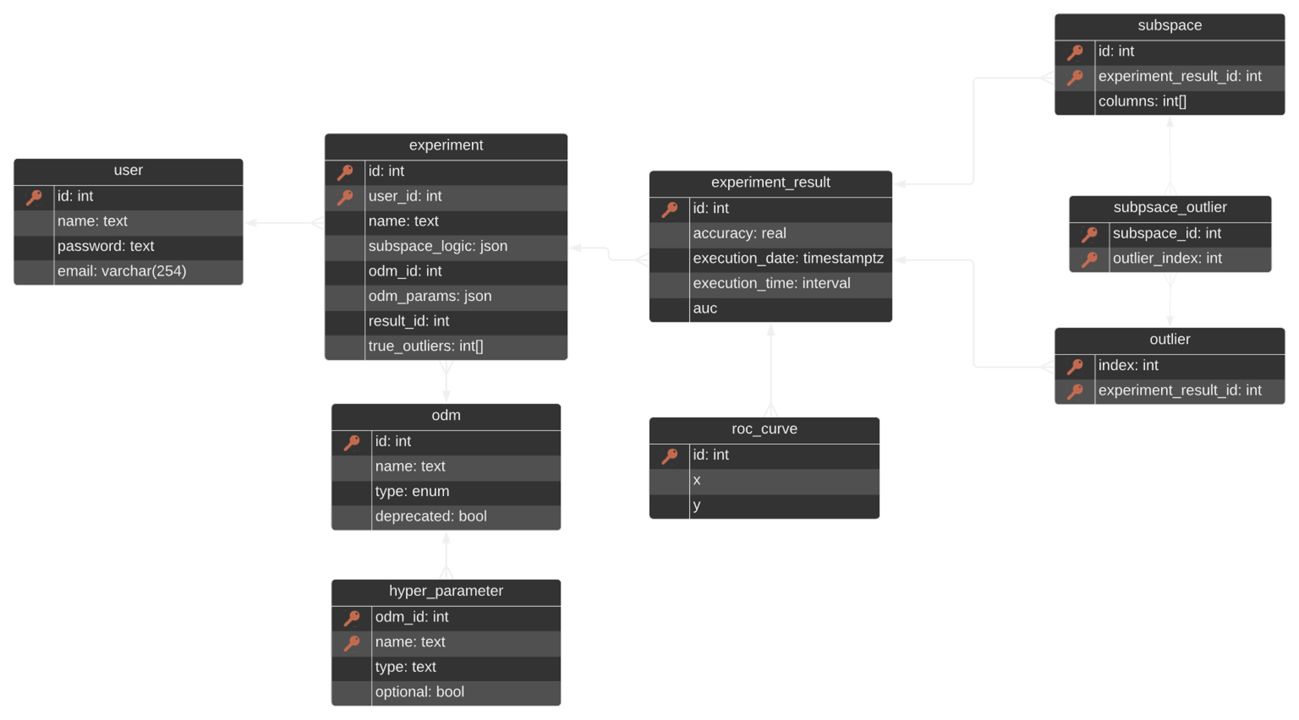


Design

Slide 17





Implementation
26 Vue Components
34 TS Files
3671 Source Code Lines
409 Comment Lines
+
34 Files
1213 Source Code Lines
608 Comment Lines
Total 4884 Source Code Lines
without empty lines, without test files

Slide 18

Quality Assurance
Frontend Jest
90% statement coverage | 78 test cases
Backend unittest
94% statement coverage | 44 test cases
ESLint
flake8

Slide 19
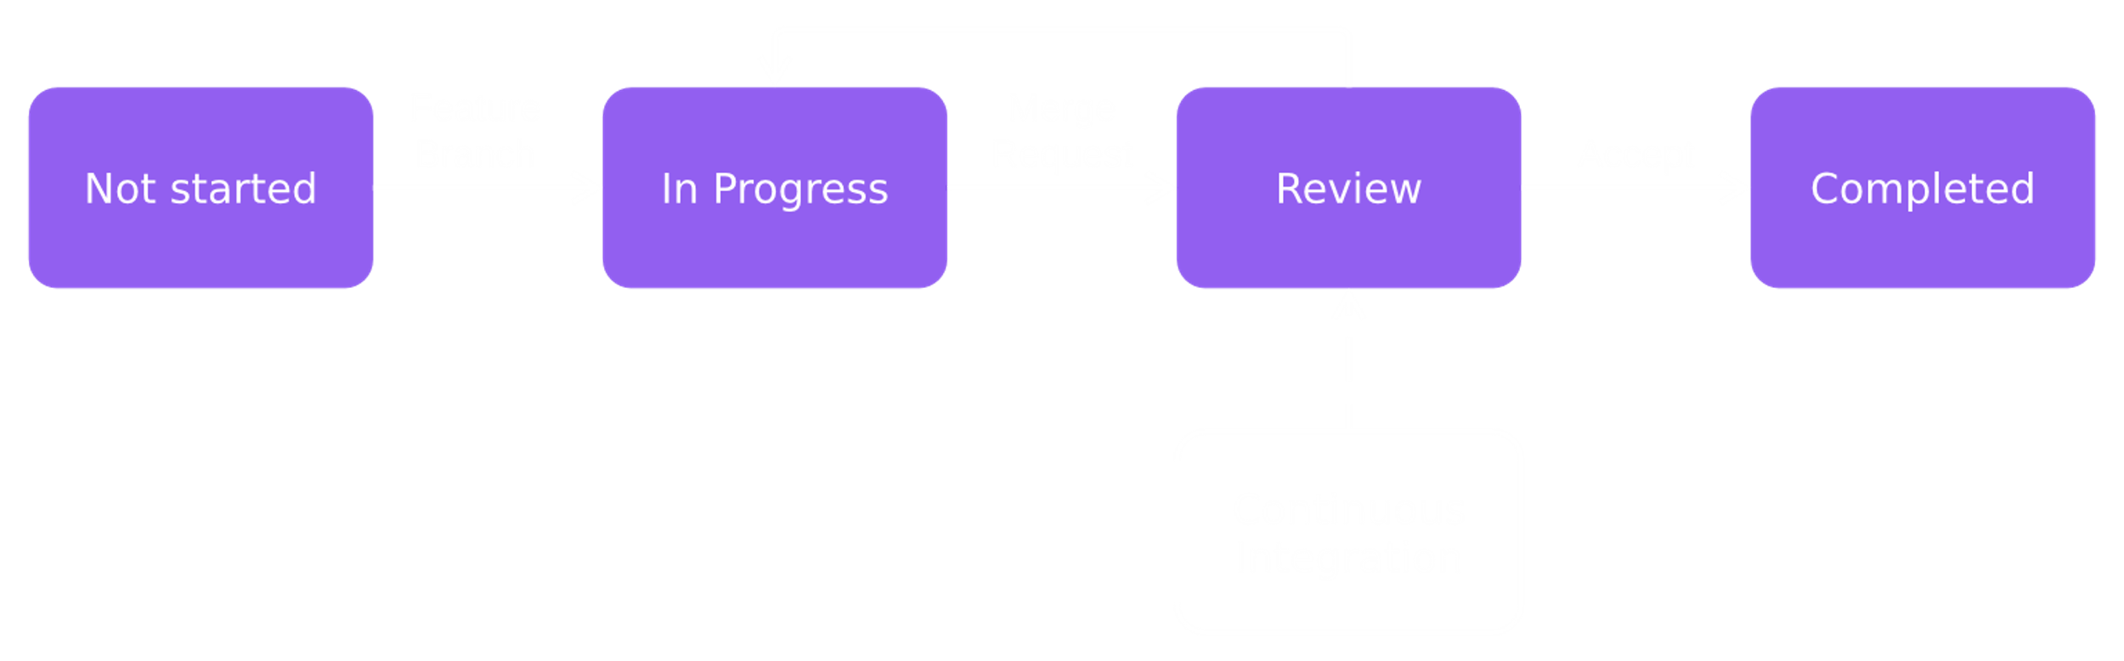
Workflow

Slide 20
Difficulties
Communication
Time management
Estimating how long tasks take
Getting used to new tools

Slide 21






Learned a Lot of Things

Slide 22
Soft Skills
Communication
Team work
Task distribution
Presenting

Slide 23
Logo Sources
Figma https://de.wikipedia.org/wiki/Figma
Overleaf https://en.wikipedia.org/wiki/Overleaf
LaTex https://de.wikipedia.org/wiki/LaTeX
Git https://de.wikipedia.org/wiki/Git
GitLab https://de.wikipedia.org/wiki/GitLab
PyCharm https://de.wikipedia.org/wiki/PyCharm
Docker https://www.prnewswire.com/news-releases/docker-and-tigera-partner-to-integrate-networking-support-for-kubernetes-on-windows-in-docker-enterprise-300853617.html
Vue https://en.wikipedia.org/wiki/Vue.js#History
TypeScript https://en.wikipedia.org/wiki/TypeScript
Python https://en.wikipedia.org/wiki/Python_(programming_language)
SQLAlchemy https://www.sqlalchemy.org/
Flask https://flask.palletsprojects.com/en/2.2.x/
ESLint https://eslint.org/branding/

Slide 24
Thank you for listening!
Bennet Hörmann, Salomo Hummel, Simeon Schrape, Erik Wu, Udo Zucker

